Slide 1
SWAG Pilot Project
Financial Aid and Scholarship Communication

Slide 2
Communication is changing

Slide 3
From one to one, to many to many

Slide 4
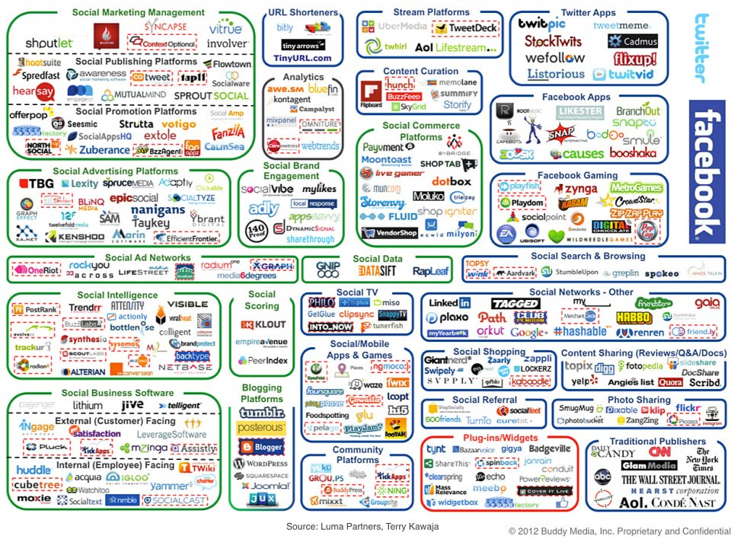

Slide 5
CCC Social Web Action Group
Public Affairs
Web
ASG
Student Leadership
Athletics
The Print
Distance Learning
Foundation
Enrollment Services
Student Services
Campus Services
Facilities
Call Center
Campus Safety

Slide 6
SWAG goal: to effectively communicate our messages through digital channels
Think strategically about communication: How do we support CCC priorities?
Coordinate among team members to ensure cross promotion of content , activities and information for optimal awareness
Increase recall of messages
Reinforce core messages

Slide 7
Our pilot project
Financial Aid Scholarship Information campaign
A three-pronged approach

Slide 8
The situation and the strategy
Imagine Clackamas survey of more than 1100 people found finances is the biggest obstacle for students.
Foundation gives $500,000 in scholarships to students each year.
Only 42 scholarship applications received when we started.
Concentrated marketing/communication push to get people to financial aid information and apply for scholarships.
Support fall recruitment and enrollment.

Slide 9
Financial Aid/Scholarship Newsletter
For the first time we purchased email contacts for high school juniors and seniors, and teachers/counselors.

Slide 10
Financial Aid Scholarship and Information Center landing page
Created a landing page to drive eblast recipients and others to.

Slide 11
Online ad campaign: Facebook & Google
Created a series of about 20 Facebook and Google ads targeted to high school juniors and seniors in our district in their parents.

Slide 12
So what are the results so far?
Landing page
287 unique page views
Average time on page 01:43
Online ad campaign
374,296 impressions (4/4)
81 click throughs
Eblast
Open rate so far 3.2%
Finaid landing page
Facebook/Google ads
Eblasts to students/teachers/counselors

